Slide 1
Deadlock

Slide 2
Introduction of Deadlock in OS
A process in operating systems uses different resources and uses resources in the following way. 1) Requests a resource 2) Use the resource 3) Releases the resource

Slide 3
Deadlock
Deadlock is a situation where a set of processes are blocked because each process is holding a resource and waiting for another resource acquired by some other process.
Consider an example when two trains are coming toward each other on the same track and there is only one track, none of the trains can move once they are in front of each other.

Slide 4
Deadlock
A similar situation occurs in operating systems when there are two or more processes that hold some resources and wait for resources held by other(s).
For example, in the below diagram, Process 1 is holding Resource 1 and waiting for resource 2 which is acquired by process 2, and process 2 is waiting for resource 1.

Slide 5
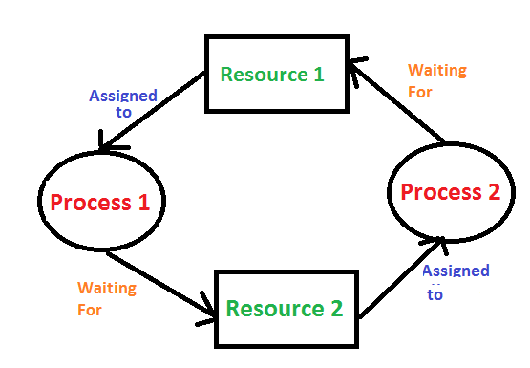
Deadlock

Slide 6
Necessary Conditions
Deadlock can arise if the following four conditions hold simultaneously (Necessary Conditions)
1.Mutual Exclusion
2.Hold and Wait
3.No Pre emption
4.Circular Wait

Slide 7
Necessary Conditions
Mutual Exclusion: One or more than one resource are non-shareable (Only one process can use at a time)
Hold and Wait: A process is holding at least one resource and waiting for resources.
No Pre emption: A resource cannot be taken from a process unless the process releases the resource.
Circular Wait: A set of processes are waiting for each other in circular form.

Slide 8
Strategies for handling Deadlock
1. Deadlock Ignorance
Deadlock Ignorance is the most widely used approach among all the mechanism. This is being used by many operating systems mainly for end user uses.
In this approach, the Operating system assumes that deadlock never occurs. It simply ignores deadlock.
This approach is best suitable for a single end user system where User uses the system only for browsing and all other normal stuff.

Slide 9
Continued...
There is always a trade off between Correctness and performance. The operating systems like Windows and Linux mainly focus upon performance.
However, the performance of the system decreases if it uses deadlock handling mechanism all the time if deadlock happens 1 out of 100 times then it is completely unnecessary to use the deadlock handling mechanism all the time.
In these types of systems, the user has to simply restart the computer in the case of deadlock. Windows and Linux are mainly using this approach.

Slide 10
2. Deadlock prevention
Deadlock happens only when Mutual Exclusion, hold and wait, No pre emption and circular wait holds simultaneously.
If it is possible to violate one of the four conditions at any time then the deadlock can never occur in the system.
The idea behind the approach is very simple that we have to fail one of the four conditions but there can be a big argument on its physical implementation in the system.

Slide 11
3. Deadlock avoidance
In deadlock avoidance, the operating system checks whether the system is in safe state or in unsafe state at every step which the operating system performs.
The process continues until the system is in safe state. Once the system moves to unsafe state, the OS has to backtrack one step.
In simple words, The OS reviews each allocation so that the allocation doesn't cause the deadlock in the system.

Slide 12
4. Deadlock detection and recovery
This approach let the processes fall in deadlock and then periodically check whether deadlock occur in the system or not.
If it occurs then it applies some of the recovery methods to the system to get rid of deadlock.

Slide 13
Deadlock Prevention

Slide 14
Deadlock Prevention
If we simulate deadlock with a table which is standing on its four legs then we can also simulate four legs with the four conditions which when occurs simultaneously, cause the deadlock.
However, if we break one of the legs of the table then the table will fall definitely. The same happens with deadlock, if we can be able to violate one of the four necessary conditions and don't let them occur together then we can prevent the deadlock.

Slide 15
1.Mutual Exclusion
Mutual section from the resource point of view is the fact that a resource can never be used by more than one process simultaneously which is fair enough but that is the main reason behind the deadlock.
If a resource could have been used by more than one process at the same time then the process would have never been waiting for any resource.
However, if we can be able to violate resources behaving in the mutually exclusive manner then the deadlock can be prevented.

Slide 16
Spooling
For a device like printer, spooling can work. There is a memory associated with the printer which stores jobs from each of the process into it.
Later, Printer collects all the jobs and print each one of them according to FCFS. By using this mechanism, the process doesn't have to wait for the printer and it can continue whatever it was doing.
Later, it collects the output when it is produced.

Slide 17
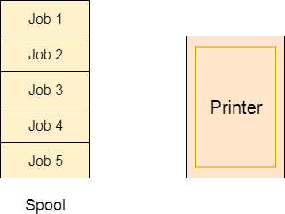
Spooling

Slide 18
Spooling
Although, Spooling can be an effective approach to violate mutual exclusion but it suffers from two kinds of problems.
1.This cannot be applied to every resource.
2.After some point of time, there may arise a race condition between the processes to get space in that spool.
We cannot force a resource to be used by more than one process at the same time since it will not be fair enough and some serious problems may arise in the performance. Therefore, we cannot violate mutual exclusion for a process practically.

Slide 19
2. Hold and Wait
Hold and wait condition lies when a process holds a resource and waiting for some other resource to complete its task. Deadlock occurs because there can be more than one process which are holding one resource and waiting for other in the cyclic order.
However, we have to find out some mechanism by which a process either doesn't hold any resource or doesn't wait. That means, a process must be assigned all the necessary resources before the execution starts. A process must not wait for any resource once the execution has been started.

Slide 20
!(Hold and wait) = !hold or !wait (negation of hold and wait is, either you don't hold or you don't wait)
This can be implemented practically if a process declares all the resources initially. However, this sounds very practical but can't be done in the computer system because a process can't determine necessary resources initially.
Process is the set of instructions which are executed by the CPU. Each of the instruction may demand multiple resources at the multiple times. The need cannot be fixed by the OS.
The problem with the approach is:
Practically not possible.
Possibility of getting starved will be increases due to the fact that some process may hold a resource for a very long time.

Slide 21
3. No Pre emption
Deadlock arises due to the fact that a process can't be stopped once it starts. However, if we take the resource away from the process which is causing deadlock then we can prevent deadlock.
This is not a good approach at all since if we take a resource away which is being used by the process then all the work which it has done till now can become inconsistent.
Consider a printer is being used by any process. If we take the printer away from that process and assign it to some other process then all the data which has been printed can become inconsistent and ineffective and also the fact that the process can't start printing again from where it has left which causes performance inefficiency.

Slide 22
4. Circular Wait
To violate circular wait, we can assign a priority number to each of the resource. A process can't request for a lesser priority resource.
This ensures that not a single process can request a resource which is being utilized by some other process and no cycle will be formed.
Among all the methods, violating Circular wait is the only approach that can be implemented practically.

Slide 23
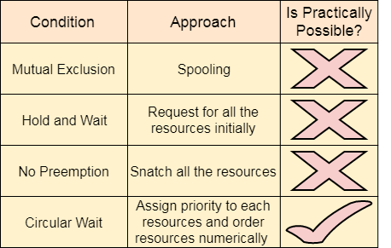
Circular wait

Slide 24
Resource Allocation Graph

Slide 25
Resource Allocation Graph
The resource allocation graph is the pictorial representation of the state of a system.
As its name suggests, the resource allocation graph is the complete information about all the processes which are holding some resources or waiting for some resources.
It also contains the information about all the instances of all the resources whether they are available or being used by the processes.
In Resource allocation graph, the process is represented by a Circle while the Resource is represented by a rectangle.

Slide 26
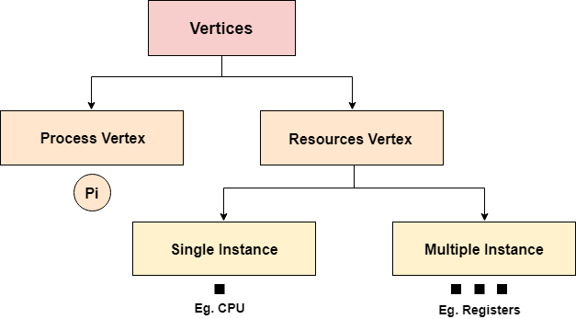
Resource Allocation Graph

Slide 27
Resource Allocation Graph
Vertices are mainly of two types, Resource and process.
Each of them will be represented by a different shape. Circle represents process while rectangle represents resource.
A resource can have more than one instance. Each instance will be represented by a dot inside the rectangle.

Slide 28
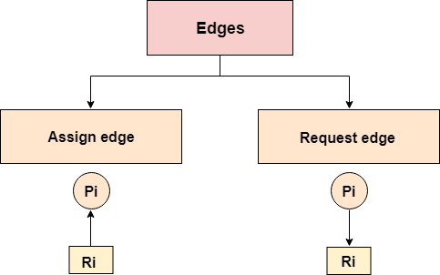
Resource Allocation Graph

Slide 29
Resource Allocation Graph
Edges in RAG are also of two types, one represents assignment and other represents the wait of a process for a resource.
A resource is shown as assigned to a process if the tail of the arrow is attached to an instance to the resource and the head is attached to a process.
A process is shown as waiting for a resource if the tail of an arrow is attached to the process while the head is pointing towards the resource.

Slide 30
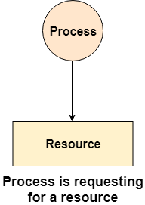
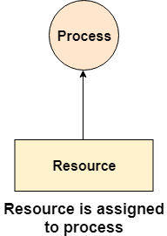
Resource Allocation Graph

Slide 31
Example
Let's consider 3 processes P1, P2 and P3, and two types of resources R1 and R2. The resources are having 1 instance each.
According to the graph, R1 is being used by P1, P2 is holding R2 and waiting for R1, P3 is waiting for R1 as well as R2.
The graph is deadlock free since no cycle is being formed in the graph.

Slide 32
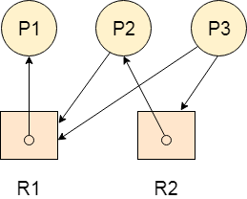
Ex:

Slide 33
Deadlock Detection using RAG

Slide 34
Deadlock Detection using RAG
If a cycle is being formed in a Resource allocation graph where all the resources have the single instance then the system is deadlocked.
In Case of Resource allocation graph with multi-instanced resource types, Cycle is a necessary condition of deadlock but not the sufficient condition.
The following example contains three processes P1, P2, P3 and three resources R1, R2, R3. All the resources are having single instances each.

Slide 35
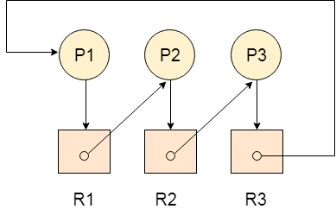
Continued...
If we analyze the graph then we can find out that there is a cycle formed in the graph since the system is satisfying all the four conditions of deadlock.

Slide 36
Allocation Matrix
Allocation matrix can be formed by using the Resource allocation graph of a system.
In Allocation matrix, an entry will be made for each of the resource assigned.
For Example, in the following matrix, an entry is being made in front of P1 and below R3 since R3 is assigned to P1.

Slide 37
Allocation Matrix
Process | R1 | R2 | R3
P1 | 0 | 0 | 1
P2 | 1 | 0 | 0
P3 | 0 | 1 | 0

Slide 38
Request Matrix
In request matrix, an entry will be made for each of the resource requested. As in the following example, P1 needs R1 therefore an entry is being made in front of P1 and below R1.
Process | R1 | R2 | R3
P1 | 1 | 0 | 0
P2 | 0 | 1 | 0
P3 | 0 | 0 | 1

Slide 39
Avail = (0,0,0)
Neither we are having any resource available in the system nor a process going to release.
Each of the process needs at least single resource to complete therefore they will continuously be holding each one of them.
We cannot ful fill the demand of at least one process using the available resources therefore the system is deadlocked as determined earlier when we detected a cycle in the graph.

Slide 40
Deadlock Detection & Recovery

Slide 41
Deadlock Detection and Recovery
In this approach, The OS doesn't apply any mechanism to avoid or prevent the deadlocks. Therefore the system considers that the deadlock will definitely occur.
In order to get rid of deadlocks, The OS periodically checks the system for any deadlock. In case, it finds any of the deadlock then the OS will recover the system using some recovery techniques.
The main task of the OS is detecting the deadlocks. The OS can detect the deadlocks with the help of Resource allocation graph.

Slide 42
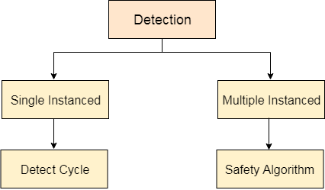

Slide 43
Single Instanced , Multiple Instanced
In single instanced resource types, if a cycle is being formed in the system then there will definitely be a deadlock.
On the other hand, in multiple instanced resource type graph, detecting a cycle is not just enough.
We have to apply the safety algorithm on the system by converting the resource allocation graph into the allocation matrix and request matrix.

Slide 44
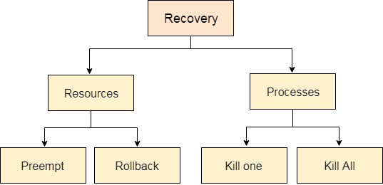
Deadlock Recovery

Slide 45
In order to recover the system from deadlocks, either OS considers resources or processes.
For Resource
Preempt the resource:
We can snatch one of the resources from the owner of the resource (process) and give it to the other process with the expectation that it will complete the execution and will release this resource sooner. Well, choosing a resource which will be snatched is going to be a bit difficult.

Slide 46
Rollback to a safe state
System passes through various states to get into the deadlock state. The operating system can rollback the system to the previous safe state. For this purpose, OS needs to implement check pointing at every state.
The moment, we get into deadlock, we will rollback all the allocations to get into the previous safe state.

Slide 47
For Process
Kill a process:
Killing a process can solve our problem but the bigger concern is to decide which process to kill. Generally, Operating system kills a process which has done least amount of work until now.
Kill all process:
This is not a suggestible approach but can be implemented if the problem becomes very serious. Killing all process will lead to inefficiency in the system because all the processes will execute again from starting.

Slide 48
Thank you

